Slide 1

Anthropogenic noise on temporary seismic networks: implications for monitoring arrays in the UK
Anna Horleston¹ & David Hawthorn²
¹University of Bristol, ²British Geological Survey

Slide 2
Outline
Baseline monitoring in the UK – how and why?
UKArray – what and where?
Site noise comparisons
Diurnal and seasonal variations
Ranking sites by noise
Conclusions
Implications for monitoring networks

Slide 3
Monitoring in the UK
With the introduction of the UK traffic light scheme there is a requirement for baseline monitoring for a year prior to activities, ideally with a magnitude of completeness of M_{L} = 0.0.
This presents a new challenge to our instrumentation and traditional monitoring methods.
  Borehole arrays and dense surface arrays are expensive and intrusive to the local population.
  Surface stations suffer from local noise in the frequency range of interest.

Slide 4
UKArray
Building on the BGS permanent network, UKArray is a transportable, temporary network.
The first phase is focused on the North of England with dense arrays around Kirby Misperton and Lancashire.
Real-time telemetered Guralp CMG-3ESPs and SM-6 4.5Hz borehole geophones.

Slide 5
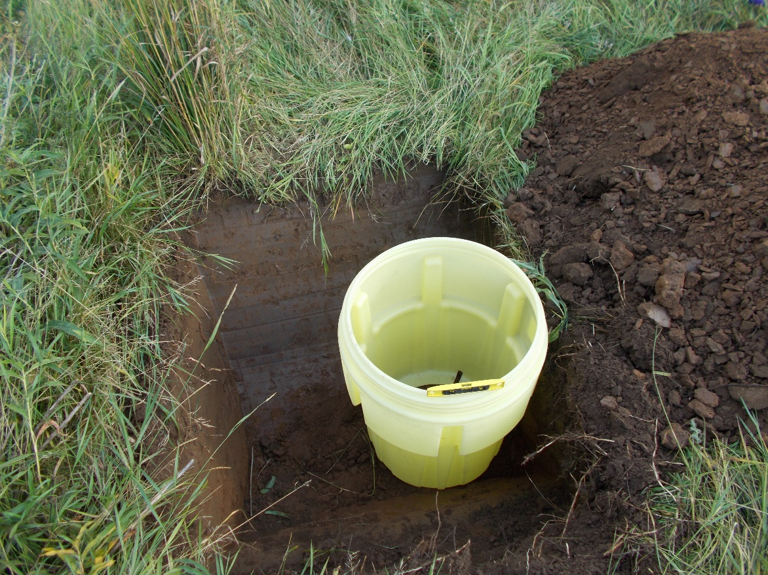
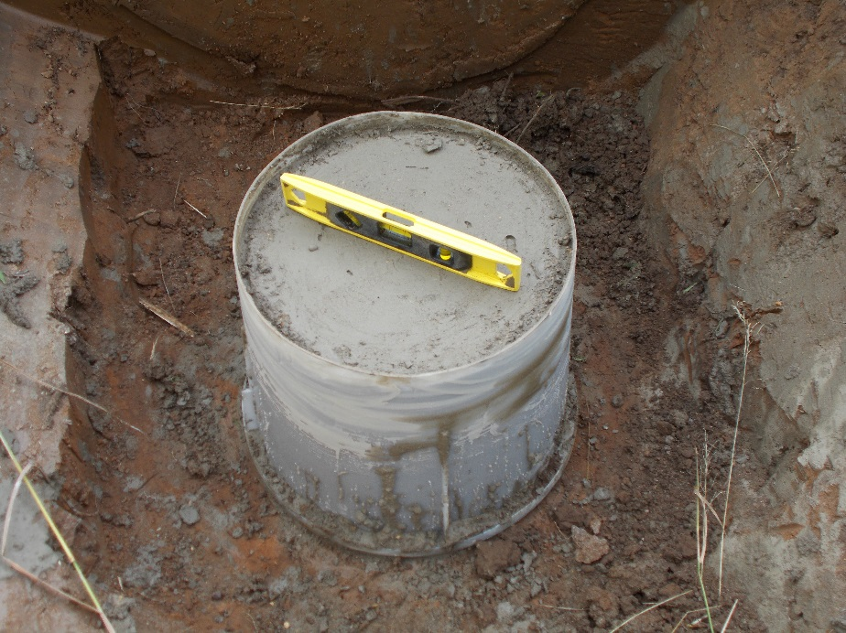
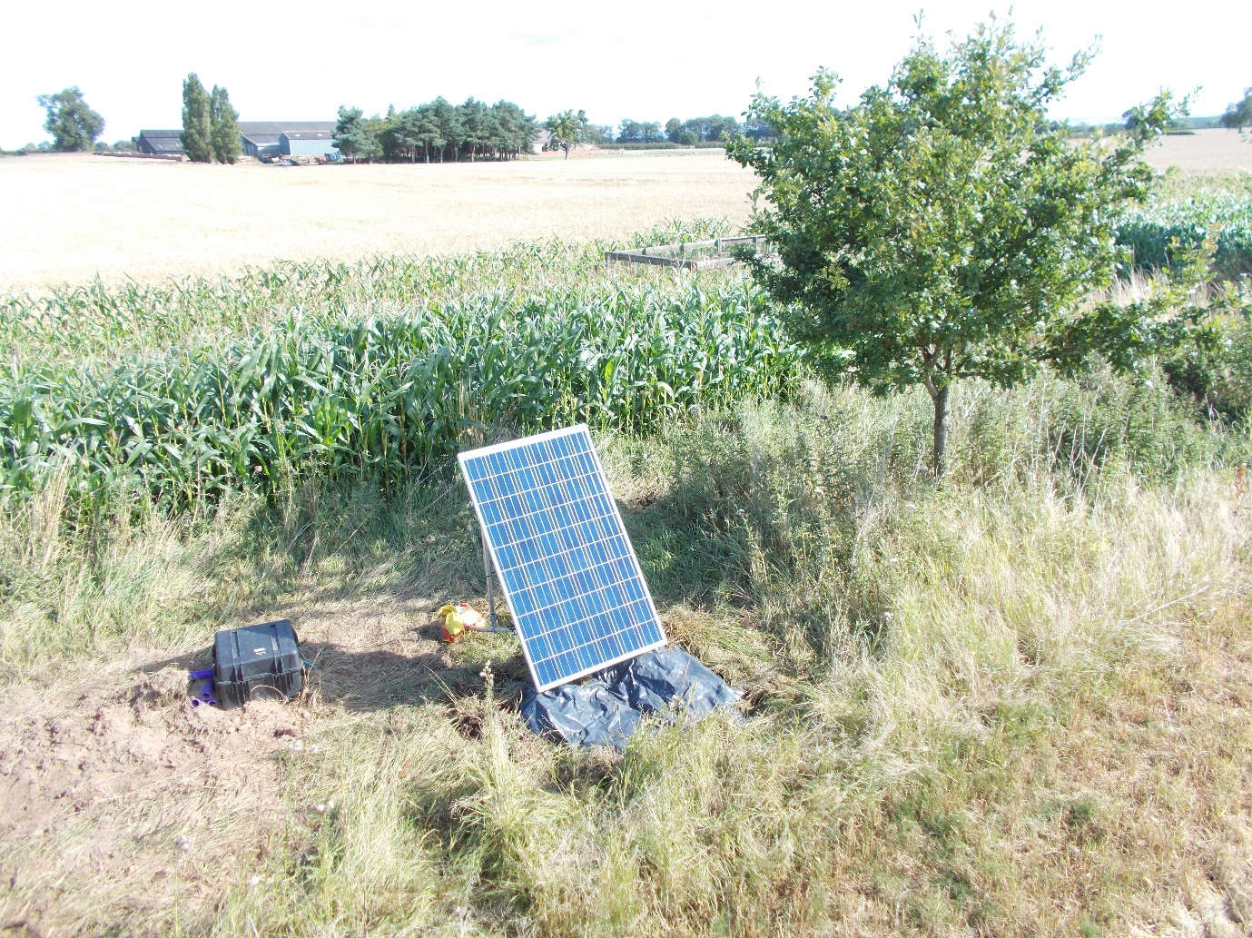
Typical Station Deployment

Slide 6
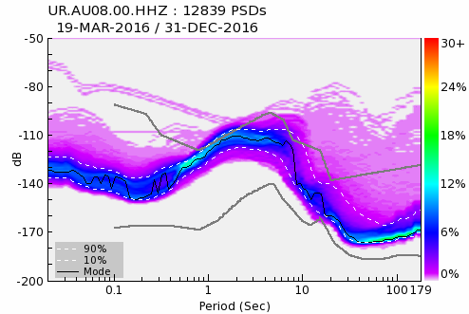
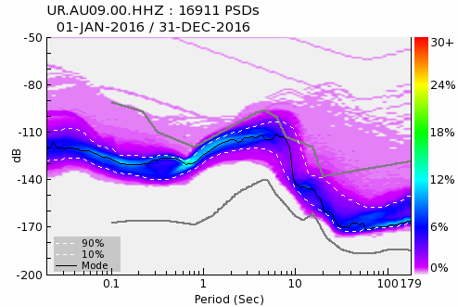
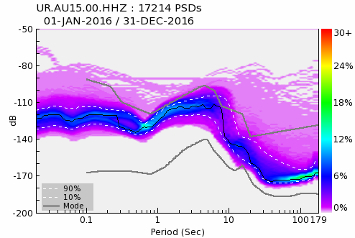
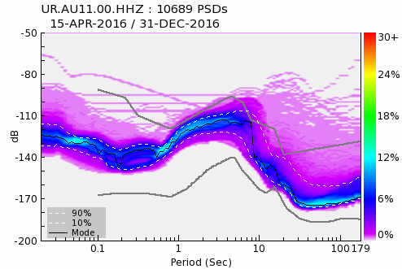
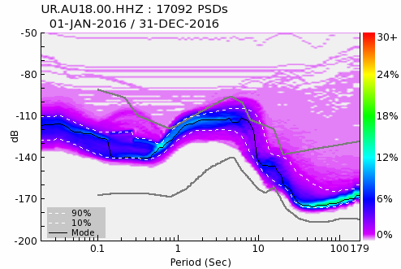
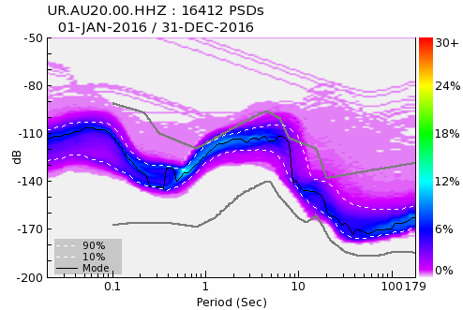
Noise Performance – PQLX

Slide 7
Summer Mode Lines - VOP

Slide 8
Diurnal Variations

Slide 9
Seasonal Variations

Slide 10
Surface vs Borehole

Slide 11
Ranking Stations by Noise - Winter
Borehole SM6
AQ07
AU13-00 Trillium borehole
AQ04
GDLE
AU13-01
AQ03
ESK
AU07 AU08
AU20

Slide 12
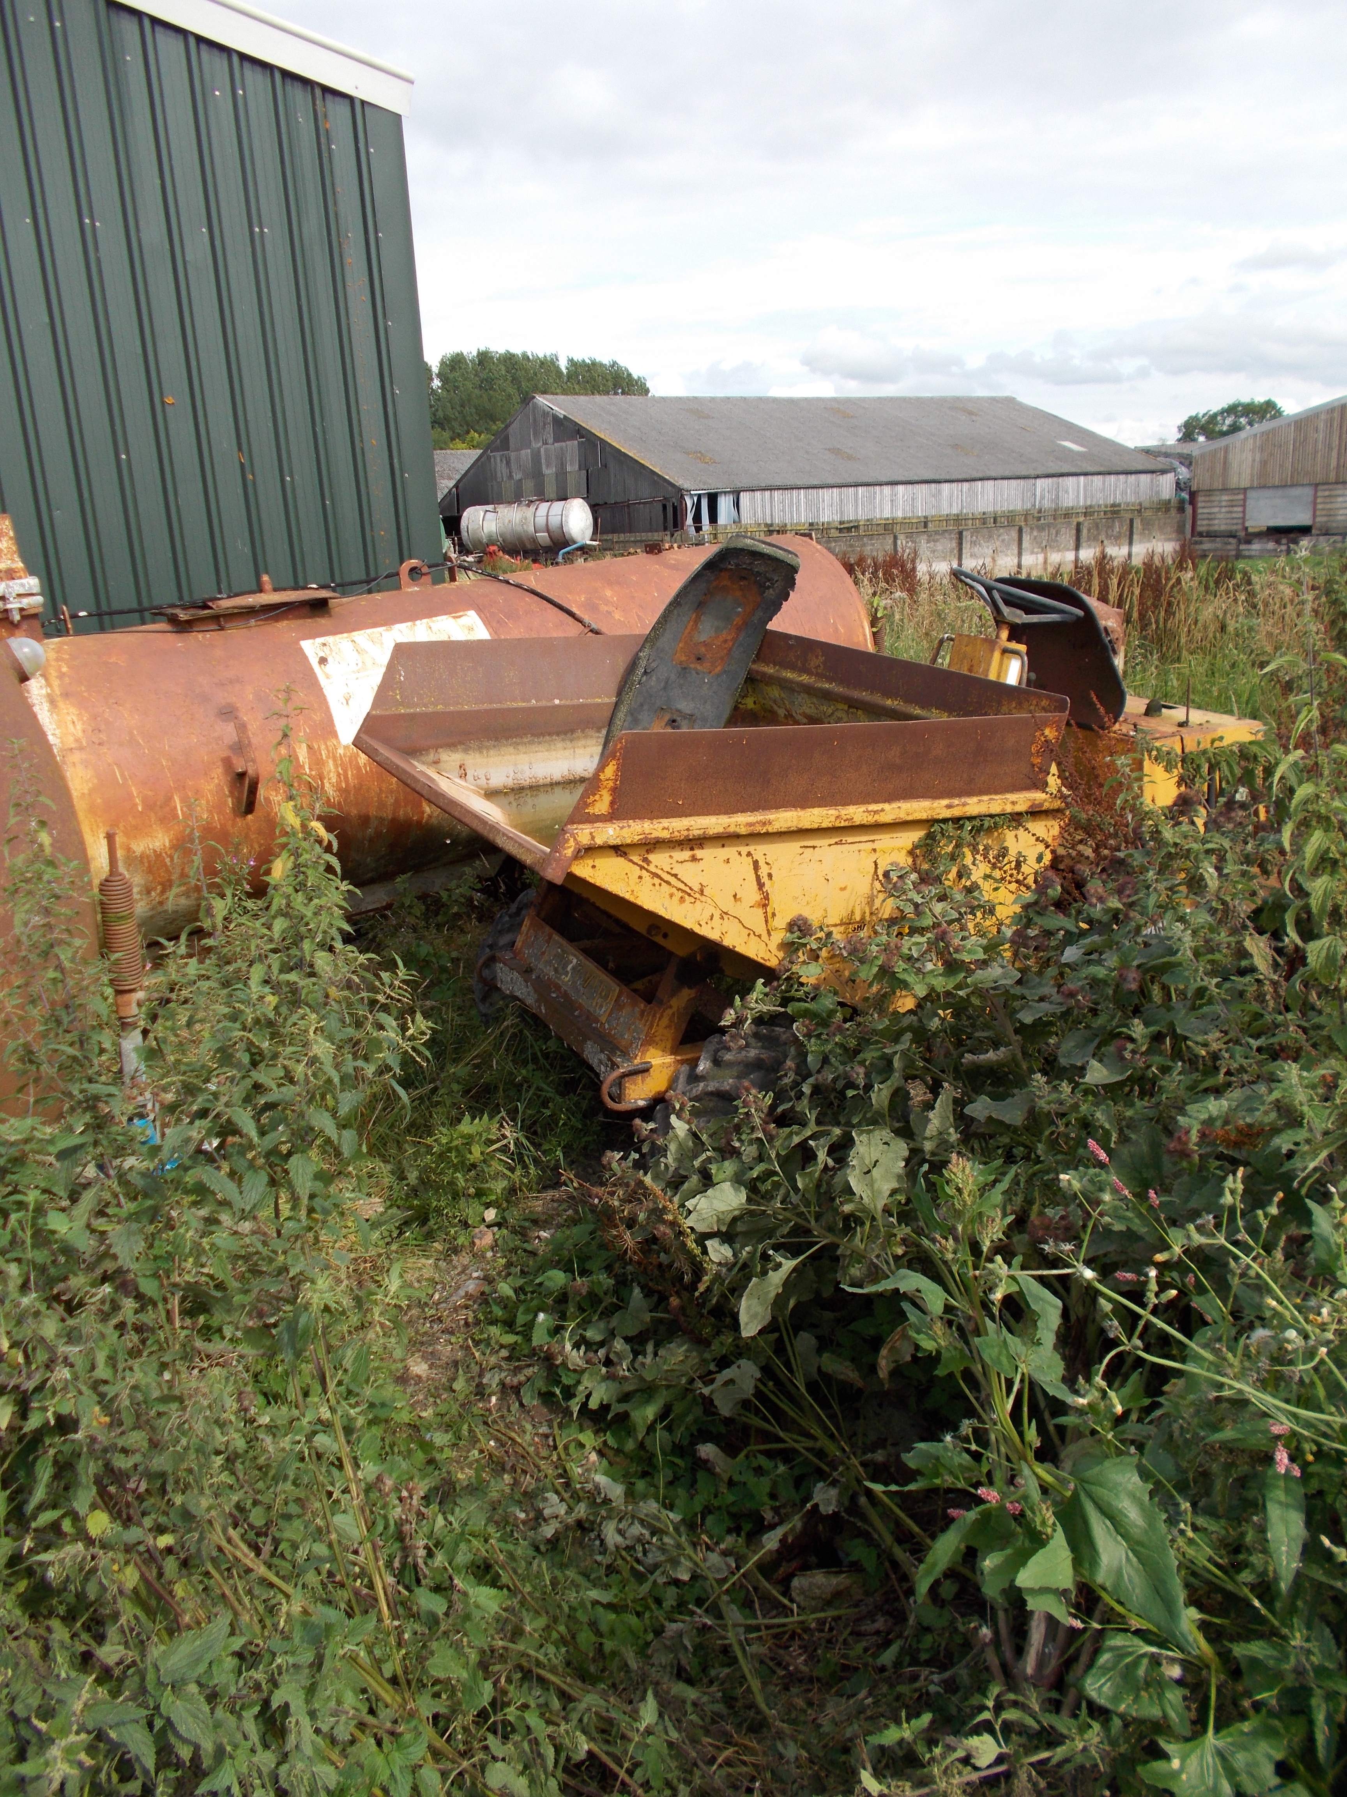
Site views
AQ03 – farmyard
AQ07 – what’s causing low frequency noise?

Slide 13
Ranking Stations by Noise - Summer
Borehole SM6
AQ07
AU07
AU13-01
Trillium borehole
GDLE
AQ04
AQ03
ESK
AU08
AU20

Slide 14
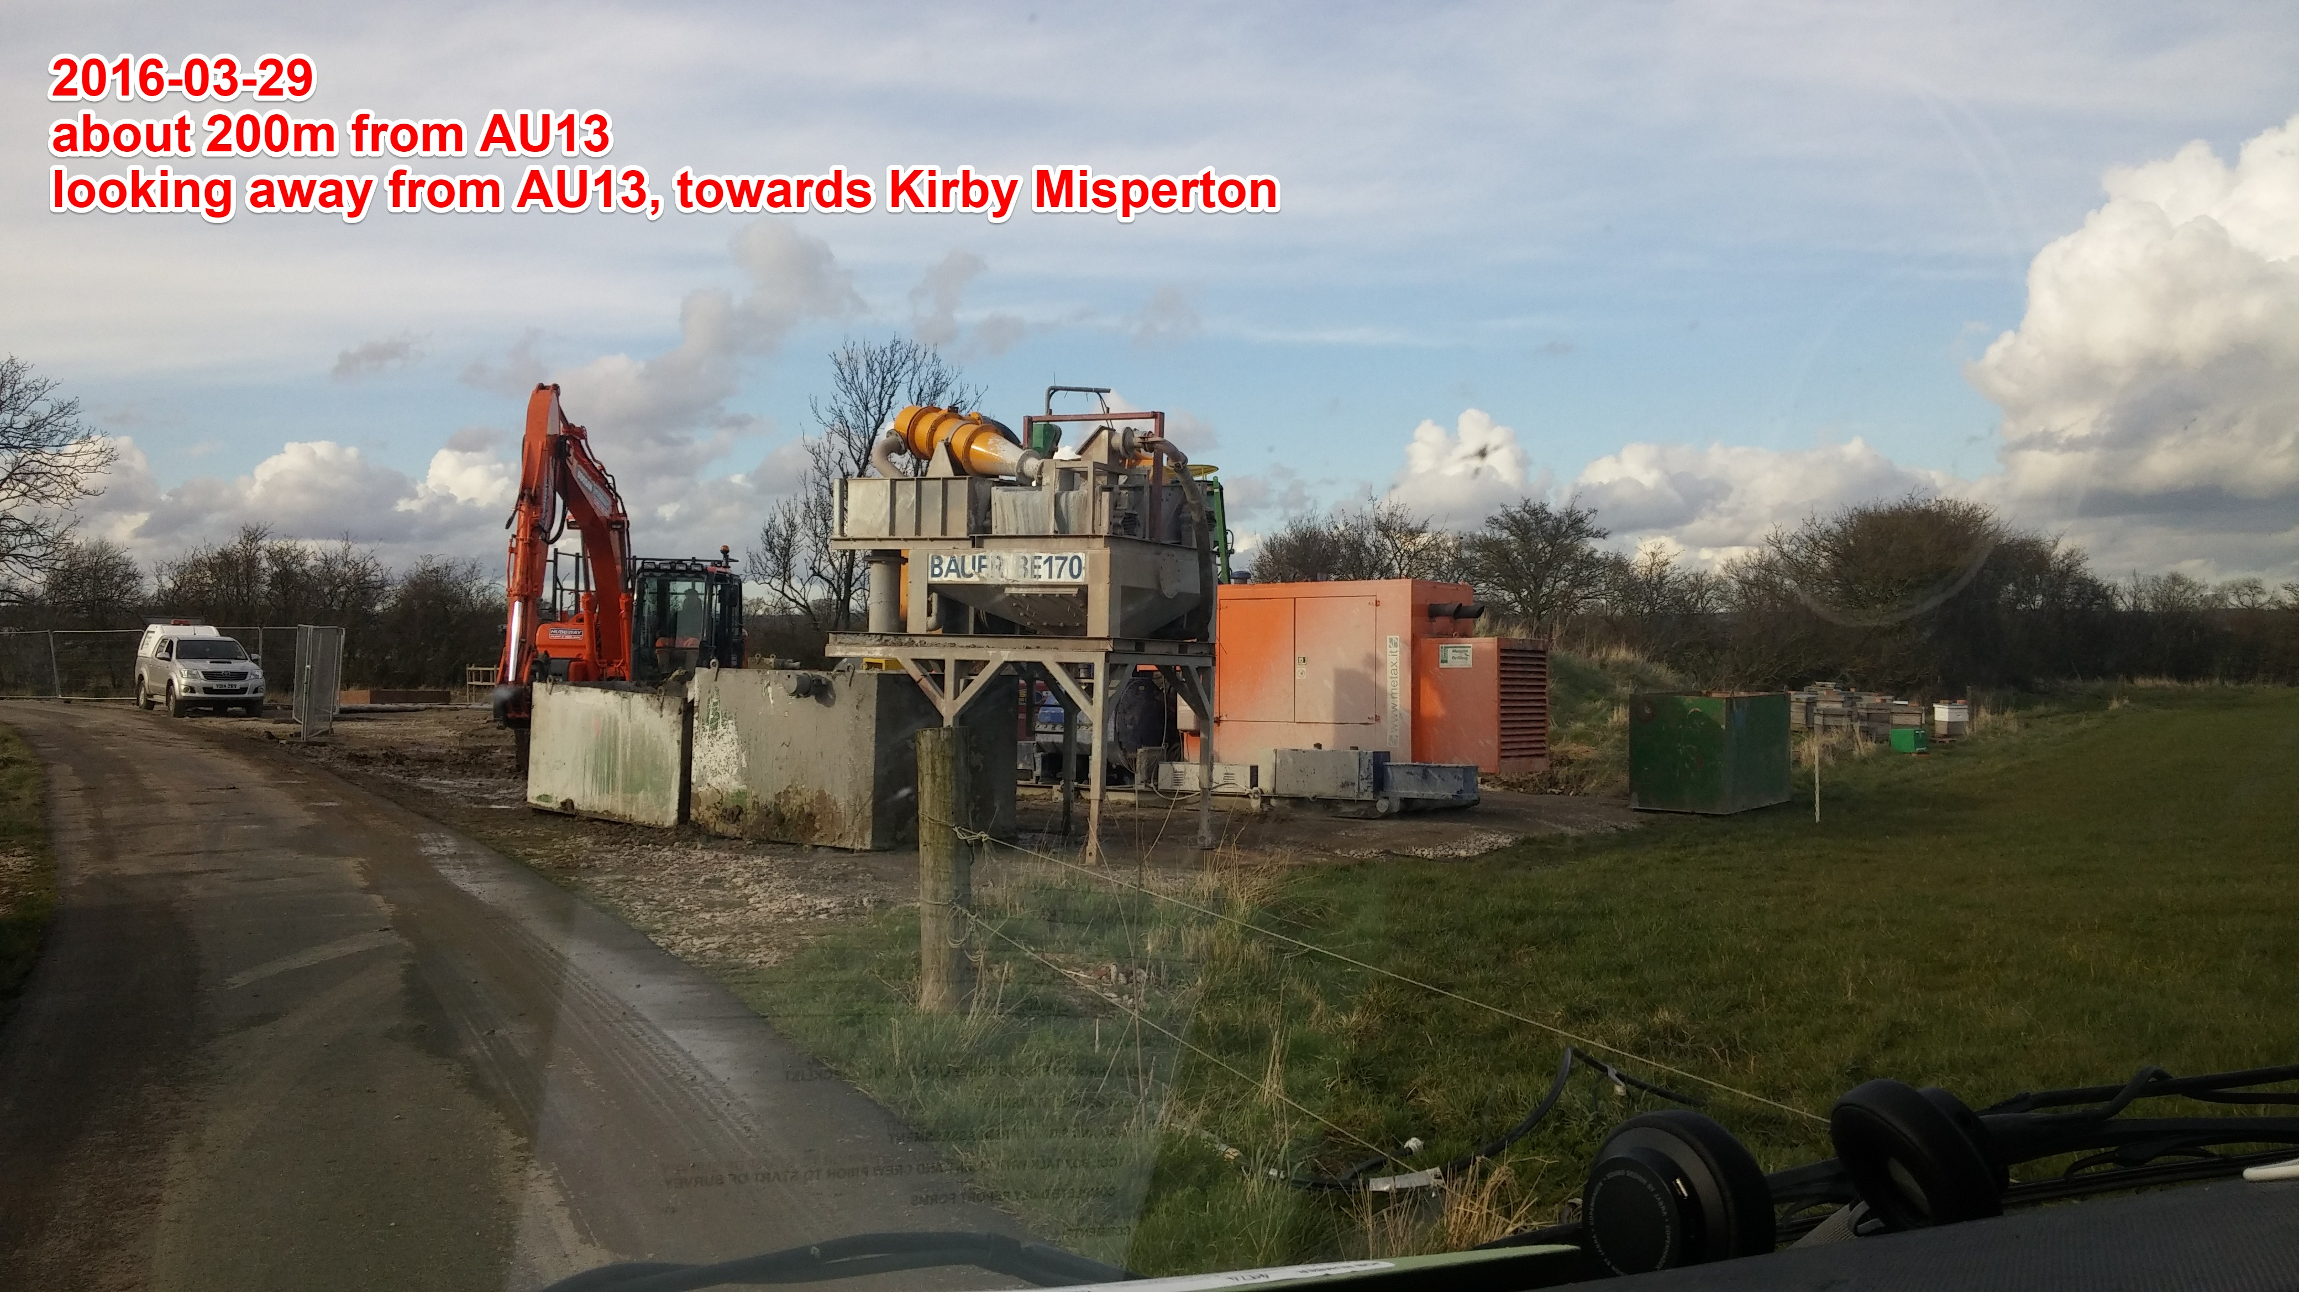
AU13 Site Noise Source

Slide 15
Station Performance Overview
The broadband borehole sensor has the best high frequency performance over time.
Location relative to local noise sources seems more important than the deployment method or soil type.
Lancashire is noisier than Yorkshire. Regional variations will affect baseline and traffic light monitoring.

Slide 16
Implications for Monitoring
High frequency noise generally arises from anthropogenic activity with diurnal, seasonal and regional variation.
A theoretical plan of a monitoring network for events <M_{L}=1.0 may not yield expected results when faced with conditions on the ground.
  Monitoring networks need to be tested for efficacy after installation and stations may need to be relocated.
Site location may well be more important than site installation method – better site selection could reduce time needed for deployments and improve results.
Data quality needs to be verified independently.

Slide 17
Acknowledgements
Thanks go to
  DBEIS for funding the Baseline Monitoring Project
  The BGS seismic team, including Brian Baptie, Richard Luckett, Heiko Buxel, Rob Clark & John Laughlin.
Any questions?
Anna.Horleston@bristol.ac.uk

Slide 18
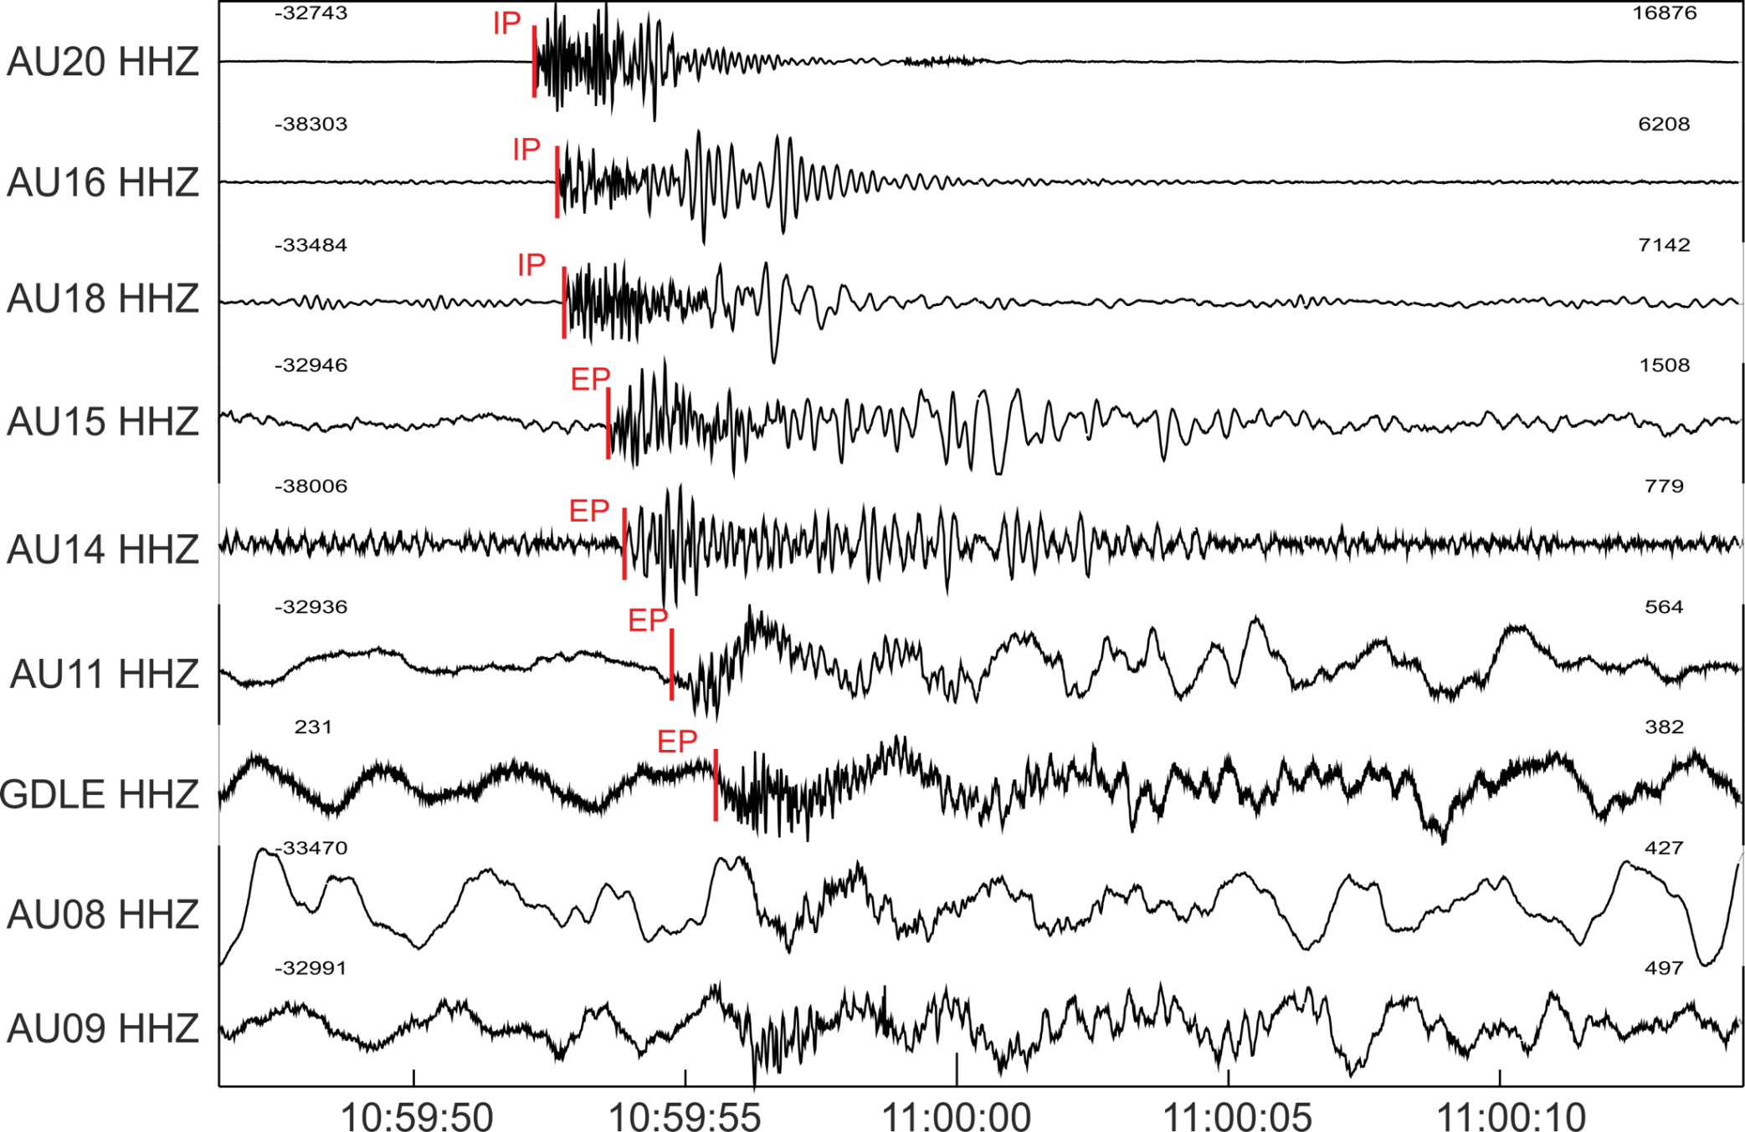
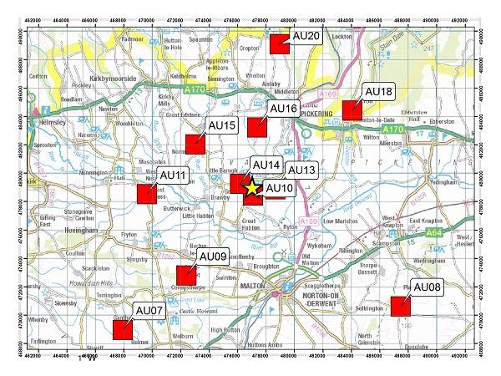
Quarry Blast in VOP
Blast from quarry North of Pickering at 10:59 on 26/7/2016. Local magnitude 1.3 ML. (Fig. from Brian Baptie)

Slide 19
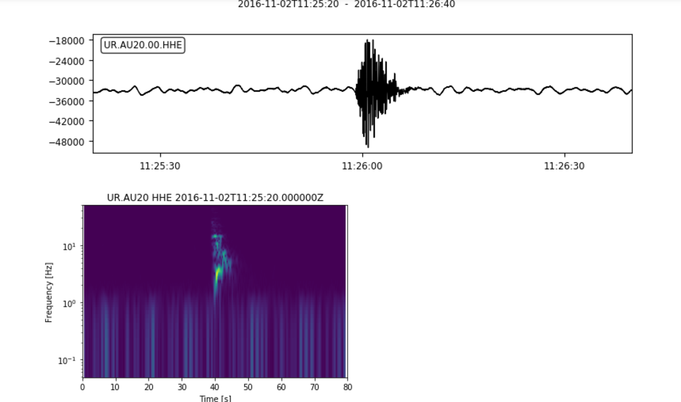
Quarry Blasts in VOP
M_{L} = 1 quarry blast located just North of Pickering as recorded at the nearest station, AU20.
Frequency content of the blast is between 1 and 20 Hz, similar to other blasts in the region.

Slide 20
Further Work
Apply beam-forming techniques for event detection (after Verdon et al. 2017) to test the impact of noise on event detection.
Compare different instrumentation – there is data available for a 6TD deployment in Lancashire (thanks to Guralp and Cuadrilla). This will be combined with our stations.
If/when fracking occurs the UKArray sites will still be in place in Lancashire and Yorkshire so we will be able to test detection methodologies with production phase data.

