Slide 1


Near-Surface Structure of the North Anatolian Fault Zone from Ambient Noise Tomography
George Taylor, Sebastian Rost, Greg Houseman and Gregor Hillers

Slide 2
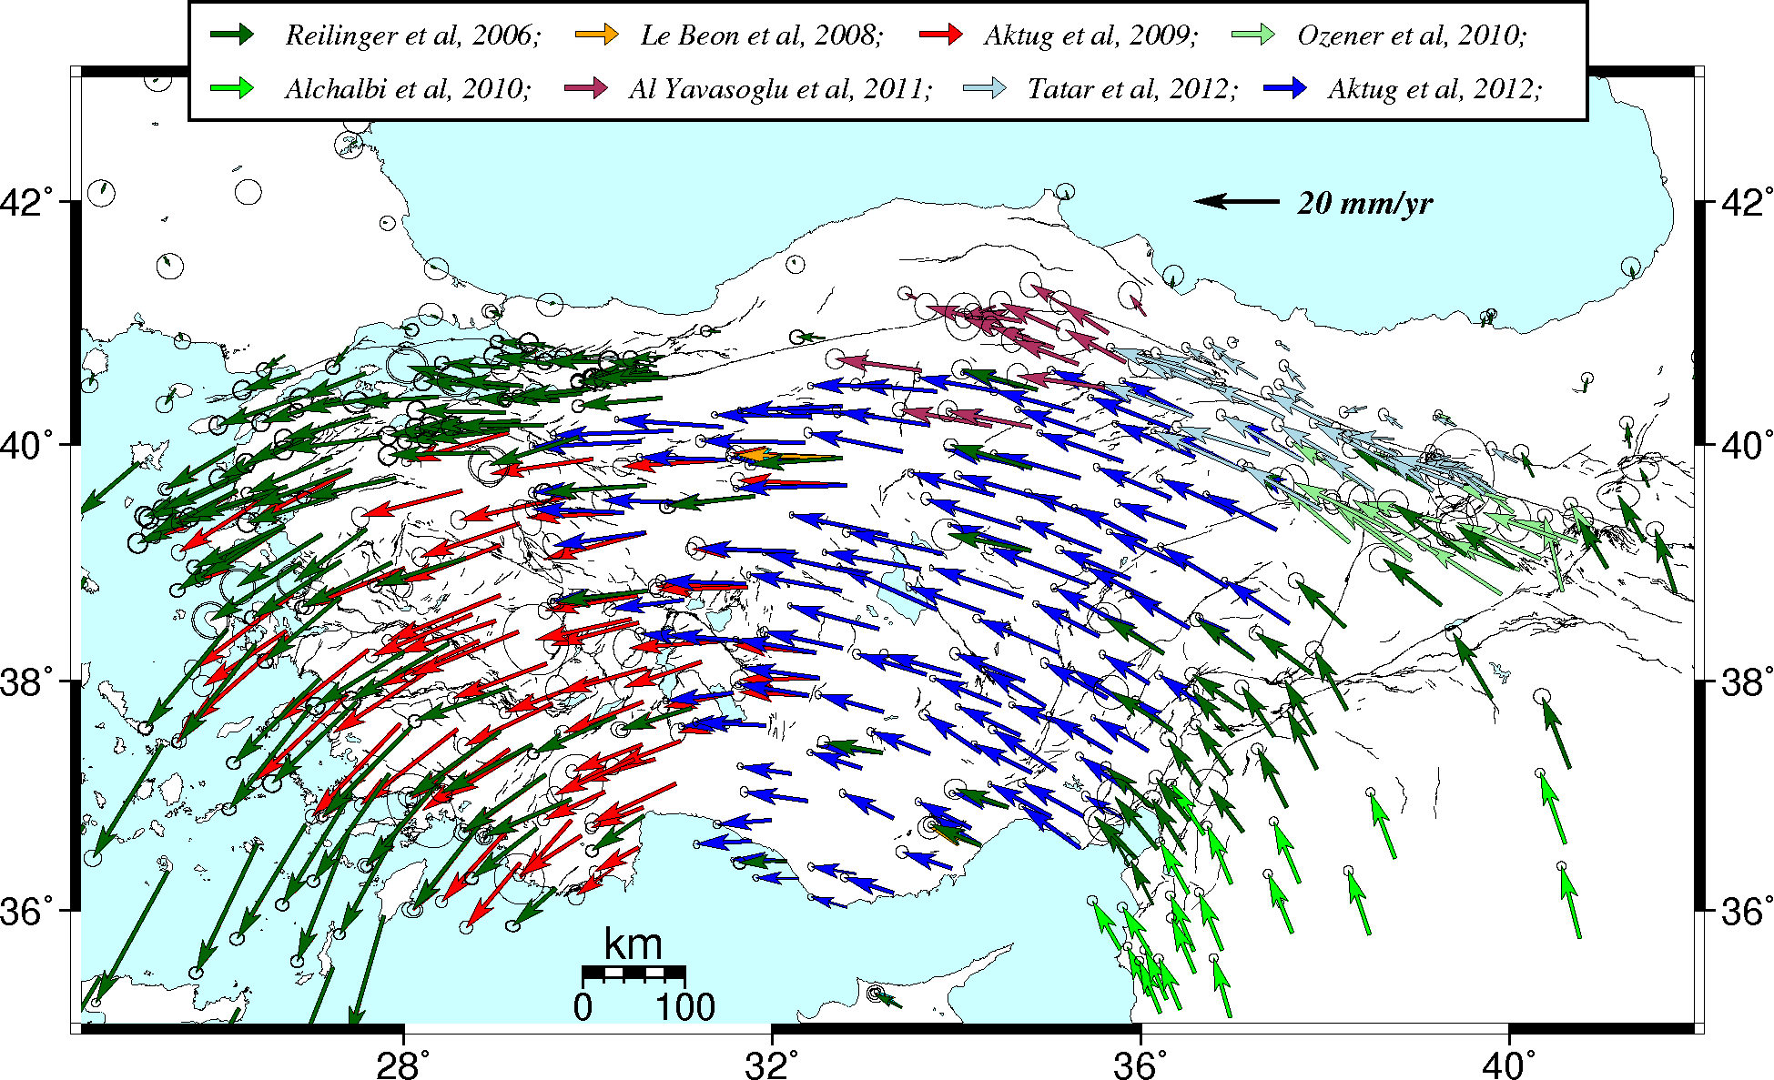
The North Anatolian Fault is a large continental transform
Arabia pushes north whilst Hellenic trench pulls south west.
The NAF is 1200 km long with a slip rate of 20-30 mm/yr.
Hussein, 2016

Slide 3
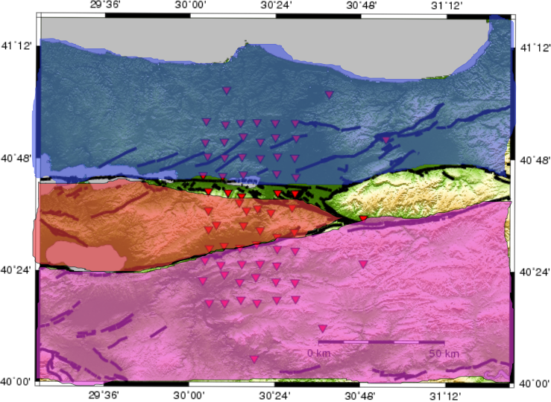
The North Anatolian Fault is a large continental transform
Arabia pushes north whilst Hellenic trench pulls south west.
The NAF is 1200 km long with a slip rate of 20-30 mm/yr.
Hussein, 2016
Istanbul Zone
We study the Marmara region
Epicentre of the 1999 Izmit and Düzce earthquakes.
Three distinct crustal blocks control the tectonics here.
Armutlu
Sakarya Terrane

Slide 4
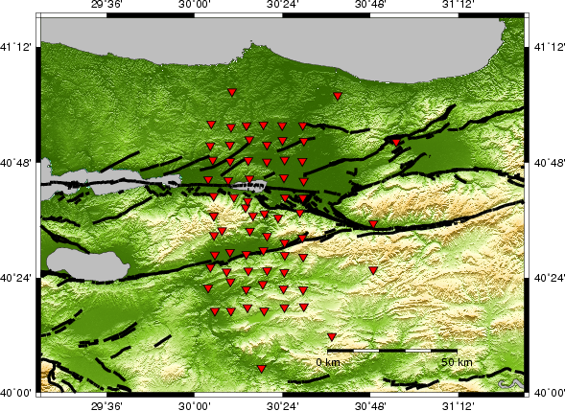
Imaging crustal structure in the rupture zone of 1999 Izmit earthquake
Izmit rupture zone
Adapazari Basin
North – Istanbul Zone: Continental fragment with deep sedimentary basin; overlain with clastic sediments.

Slide 5
Imaging crustal structure in the rupture zone of 1999 Izmit earthquake
Izmit rupture zone
Adapazari Basin
Armutlu Mountains
Pamukova Basin
North – Istanbul Zone: Continental fragment with deep sedimentary basin; overlain with clastic sediments.
Centre – Armutlu Mountains: Metamorphosed carbonates, Marbles, Granites, sedimentary Basin.

Slide 6
Imaging crustal structure in the rupture zone of 1999 Izmit earthquake
Izmit rupture zone
Adapazari Basin
Armutlu Mountains
Pamukova Basin
North – Istanbul Zone: Continental fragment with deep sedimentary basin; overlain with clastic sediments.
Centre – Armutlu Mountains: Metamorphosed carbonates, Marbles, Granites, sedimentary Basin.
South – Sakarya Terrane: Sedimentary complex of carbonates and clastic sediments.

Slide 7
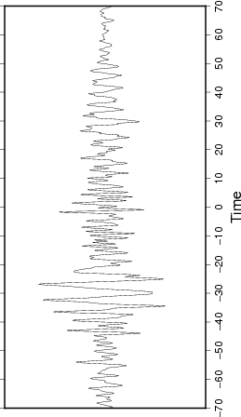
Surface wave group velocities extracted from noise correlation functions
Cross correlation function DA01 – DB10 (64 km)

Slide 8
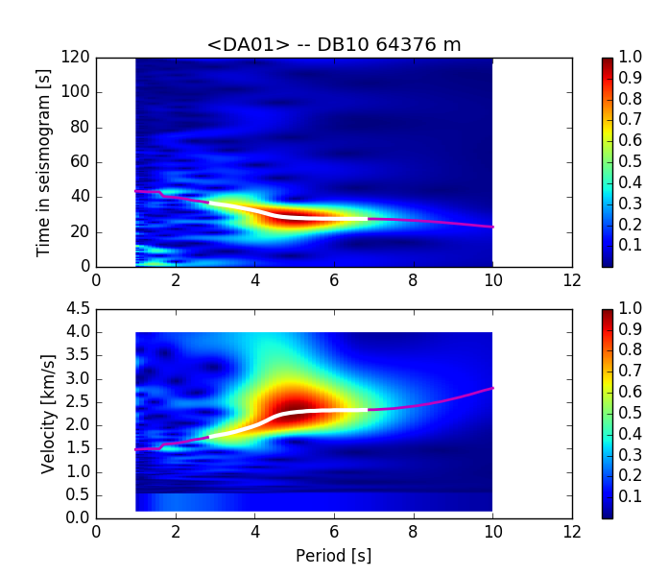
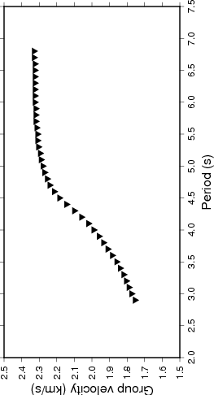
Surface wave group velocities extracted from noise correlation functions
Cross correlation function DA01 – DB10 (64 km)
Dispersion map
Dispersion curve DA01- DB10

Slide 9
Surface wave group velocities extracted from noise correlation functions
Cross correlation function DA01 – DB10 (64 km)
Group velocity vs period heat map
Dispersion curve DA01- DB10
Distance between station / group velocity = Travel time as a function of period

Slide 10
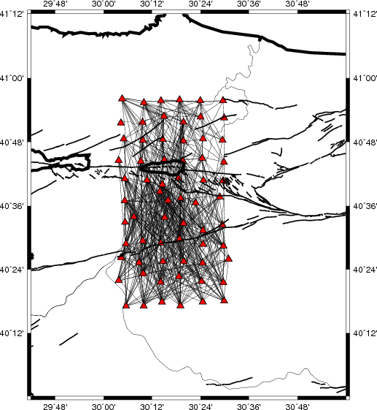
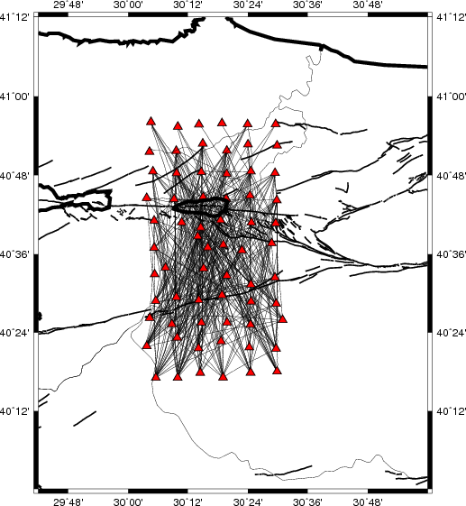
Ray path coverage for Rayleigh waves
2.5 s period
4.5 s period
Group velocity measurements made between 1.5 s and 6.0 s.
Any station pairs with a travel time residual > 5 s through a constant velocity model are removed.

Slide 11
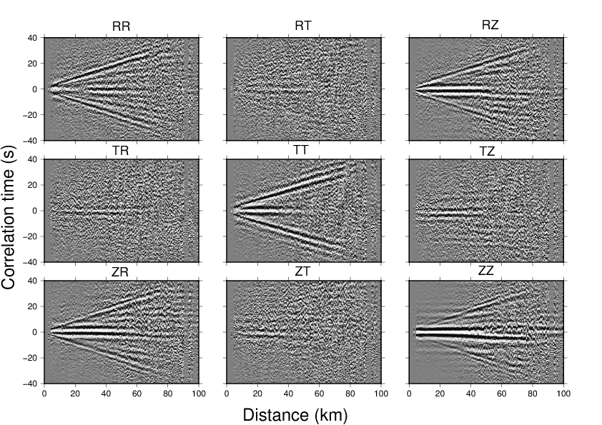
Both Rayleigh and Love waves are retrieved
ZZ, ZR, RR, RZ = Rayleigh
TT = Love
Source
Radial
(R)
Transverse
(T)
Receiver
Correlation functions are calculated for all 9 component combinations.
Rayleigh dispersion curves are computed after logarithmic stacking of ZZ, ZR, RR, RZ components (Campillo et al, 1996)

Slide 12
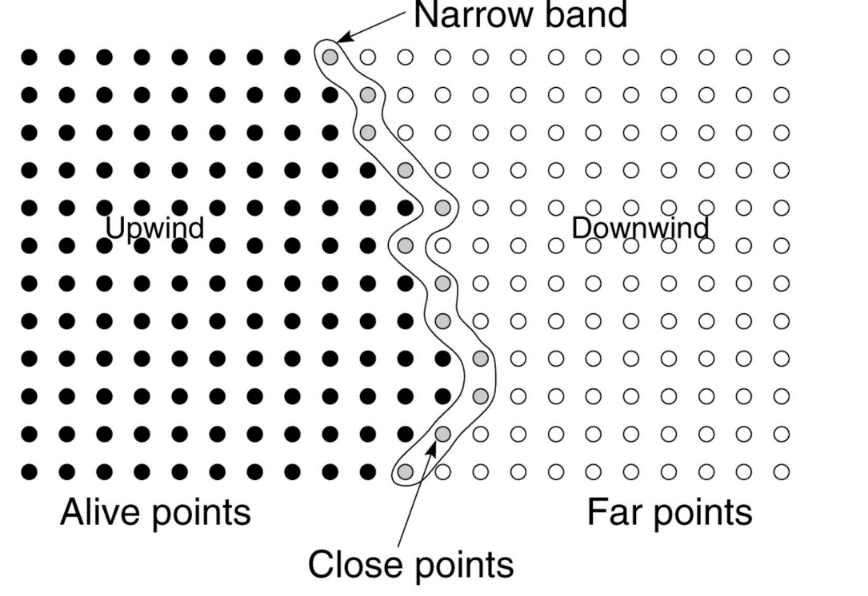

Non-linear inversion using the Fast Marching Method
Group velocity inversion (Rawlinson and Sambridge, 2005)
Start with a constant velocity model
Calculate ray paths through the model using Fast Marching Method (Sethian and Popovici, 1999).
Estimate travel times.
Minimise objective function
$$\frac{1}{2}\left[{\left\|g(m)−d_{obs}\right\|}^{2}+ε\left({\left(m−m_{0}\right)}^{T}C_{m}^{−1}\left(m−m_{0}\right)\right)\right]$$

Slide 13
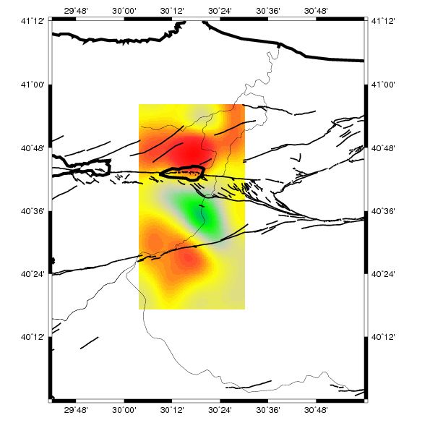
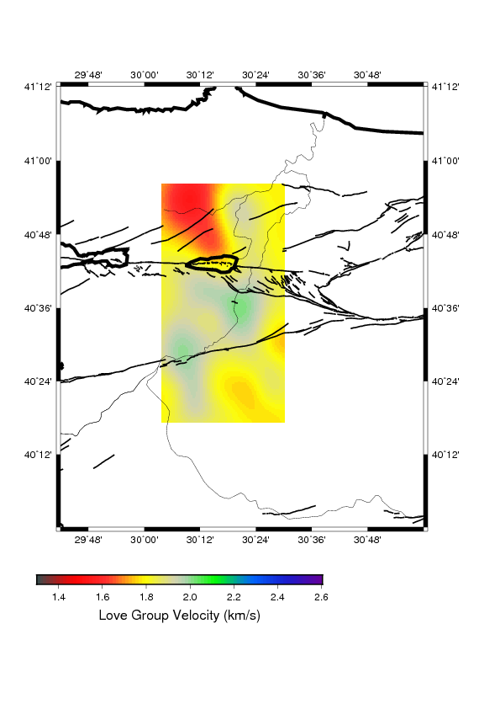
Group velocity maps – 1.5 s
Rayleigh
Love
Group velocity (km/s)
Relatively poor data coverage.
Armutlu block appears faster than Istanbul Zone or Sakarya Terrane.
Low velocities most prominent in the NW of the array. Armutlu mountains appear slightly faster.

Slide 14
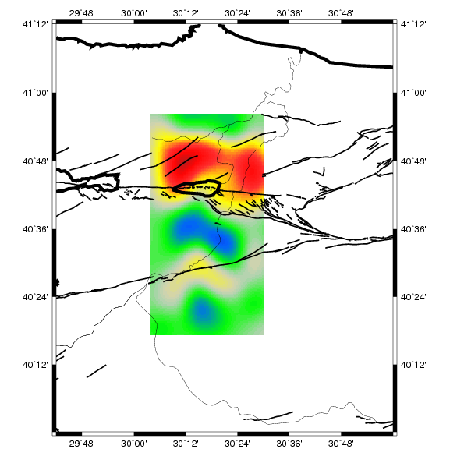
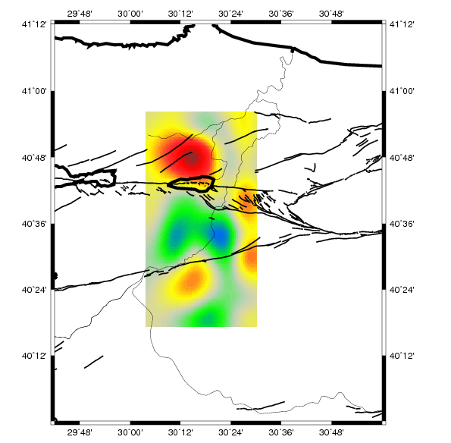
Group velocity maps – 2.5 s
Rayleigh
Love
Group velocity (km/s)
Adapazari Basin and another low velocity zone to the north of the fault, along with Pamukova Basin on southern branch. Armutlu Mountains clear.
NW anomaly prominent. Adapazari less so. Fault strands associated with strong gradients. Armutlu appears fast.

Slide 15
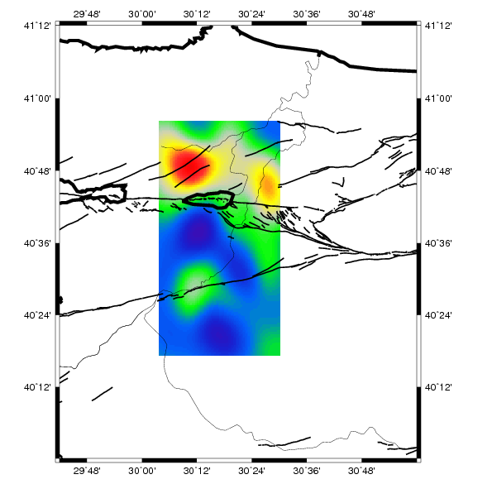
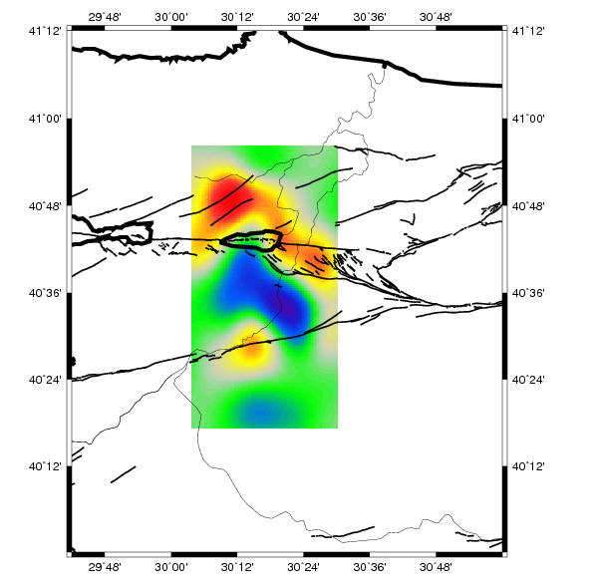
Group velocity maps – 3.5 s
Rayleigh
Love
Group velocity (km/s)
Adapazari and Pamukova still visible but less pronounced. Anomaly to the NW still strong. High velocities in Armutlu
Armutlu Mountains extremely fast. Strong velocity gradient associated with northern fault branch.

Slide 16
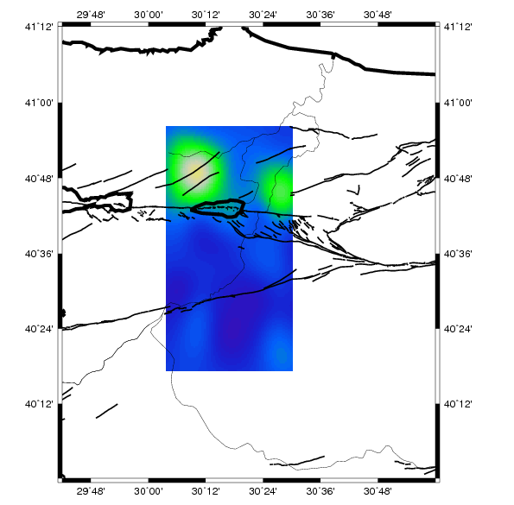
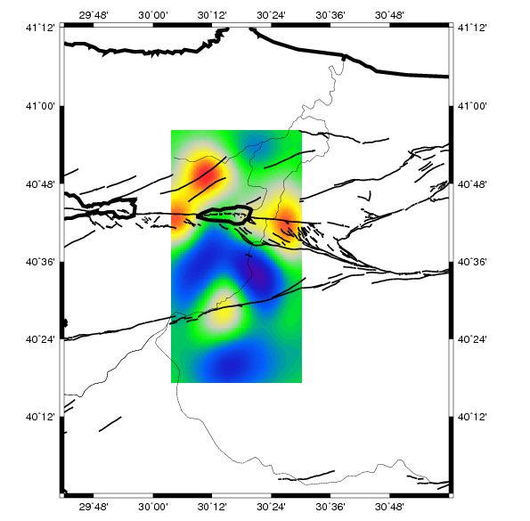
Group velocity maps – 4.5 s
Rayleigh
Love
Group velocity (km/s)
Adapazari and NW anomaly still visible. Uniform fast, potentially basement rocks across most of the image.
Strong velocity gradient near the northern branch of the fault. Armutlu mountains and Pamukova distiguishable.

Slide 17
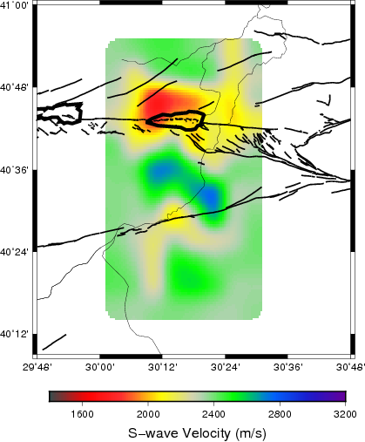
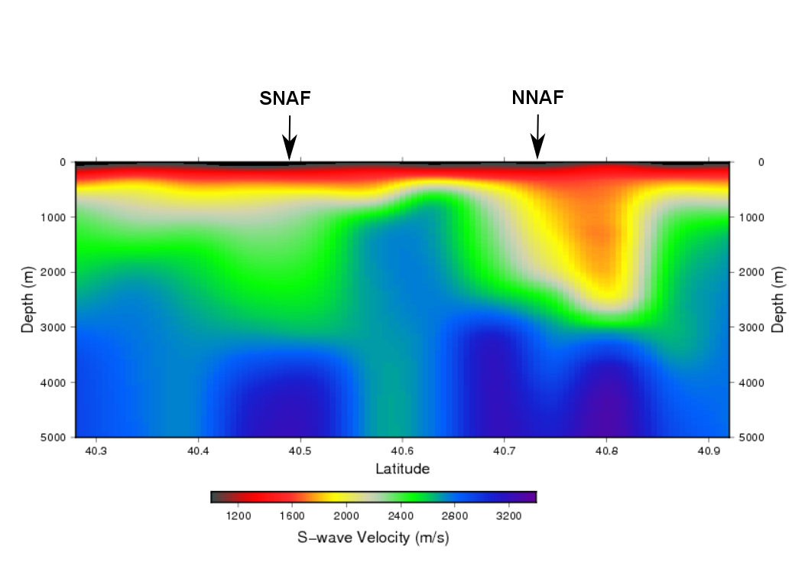
Rayleigh S-wave maps and profile
1 km depth
Wathelet, 2008.
Sambridge, 1999.
S-wave velocity inversion performed using a neighbourhood algorithm.
5000 random models are generated.
Best fitting models undergo weighted average to form S-wave velocity maps.
Low velocity anomalies near faults.
Seem to be correlated with presence of sediments / basins.

Slide 18
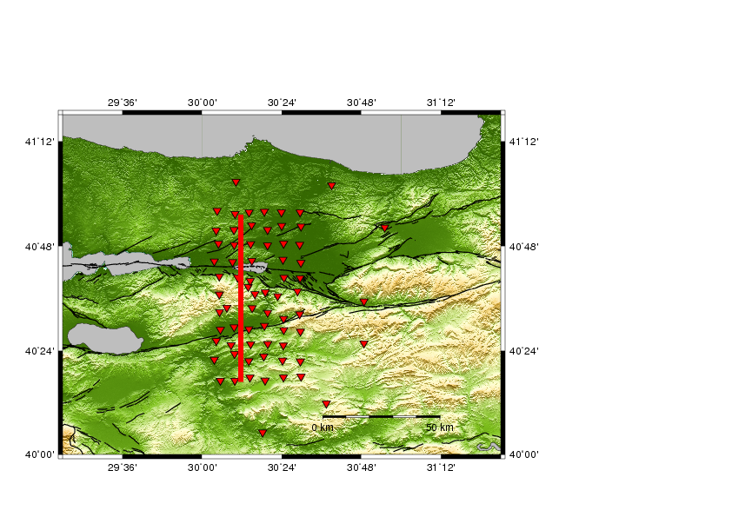
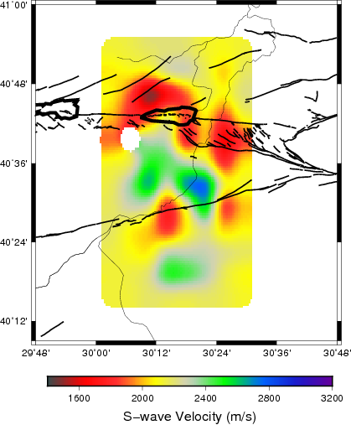
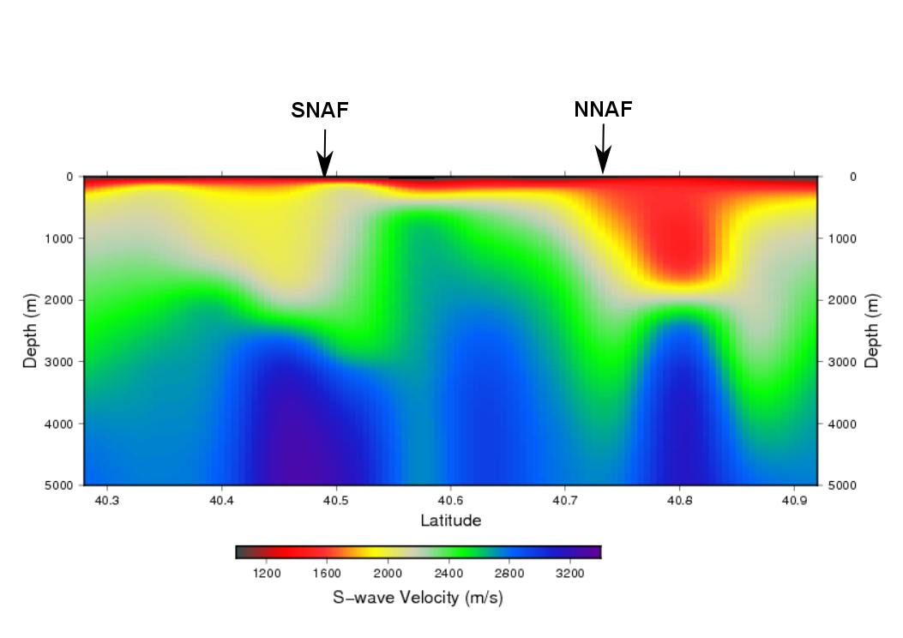
Love S-wave maps and profile
1 km depth
Wathelet, 2008.
Sambridge, 1999.
Velocities lower in general.
Difference between Love and Rayleigh implies radial anisotropy.

Slide 19
Conclusions
Low seismic velocities in the upper 3 km of both branches of the North Anatolian Fault.
Low velocities also associated with sediments in Adapazari, Pamukova and Izmit.
Metamorphic rocks in Armutlu mountains have fast seismic velocity. Both fault strands go around these units.

Slide 21
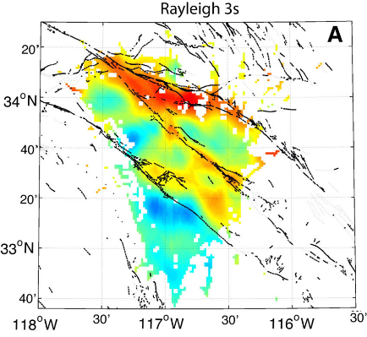
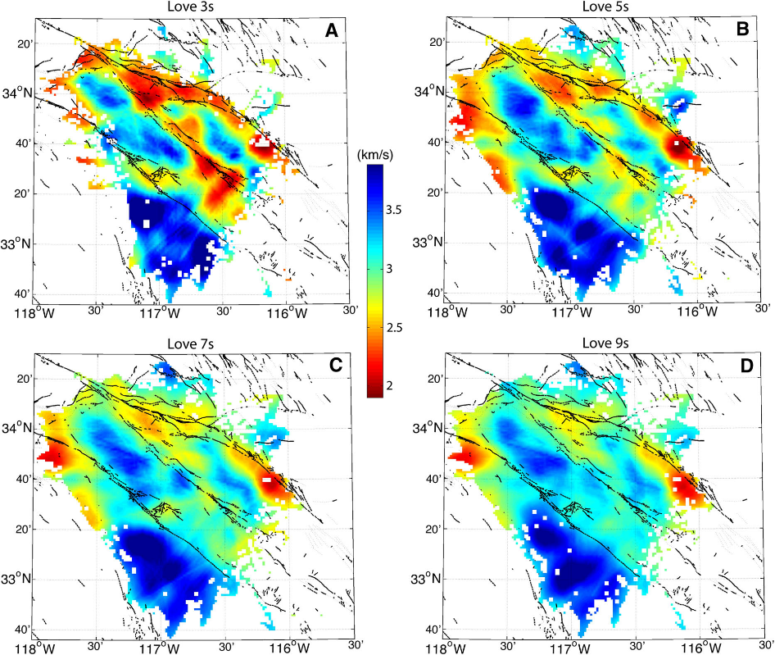
Dense arrays provide images of fault zone structure
Rayleigh and Love wave tomography of southern California.
San Andreas and San Jacinto Fault have low velocities at short periods.
Low seismic velocities can be caused by:
Presence of pull-apart sedimentary basins
Low velocity rocks formed by cumulative damage processes.
Zigone et al, 2015, Pure Appl. Geophys.

Slide 22
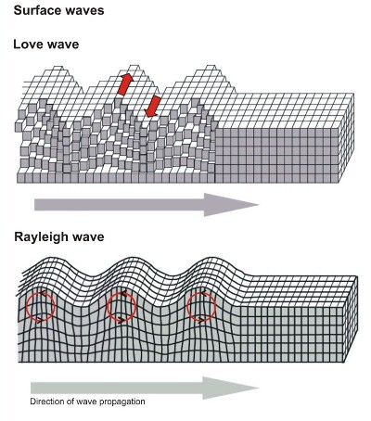
Why are Rayleigh and Love waves different?
Rayleigh
Love
Sensitive to SH velocities.
Higher sensitivity to shallow structures.
Sensitive to P and SV velocities.
Not possible to invert both together for an isotropic S-wave velocity model.
Differences between Rayleigh and Love wave tomography imply significant anisotropy.
http://www.lamit.ro/images/earthquake-l-r-waves-passage.jpg

Slide 23
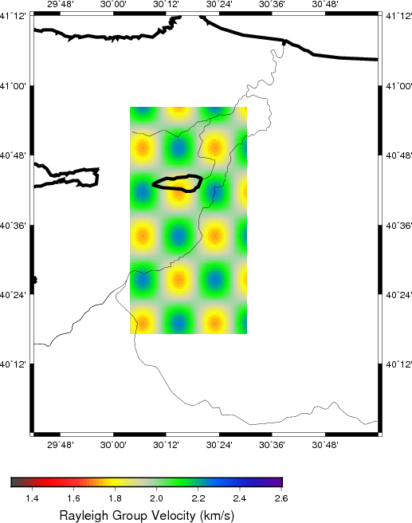
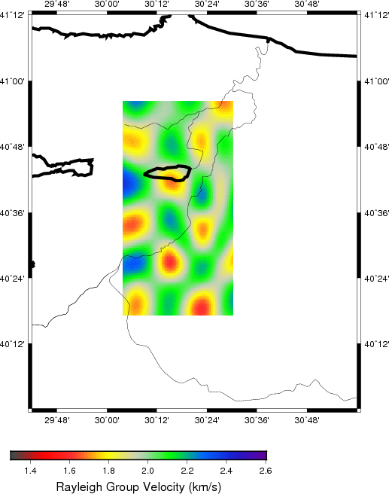
Checkerboard test at 2.5 s period
Perform inversion with our ray coverage, using travel times from synthetic model.
Synthetic velocity model

Slide 24
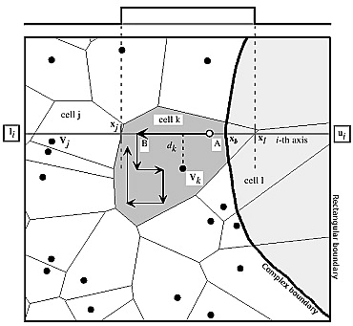
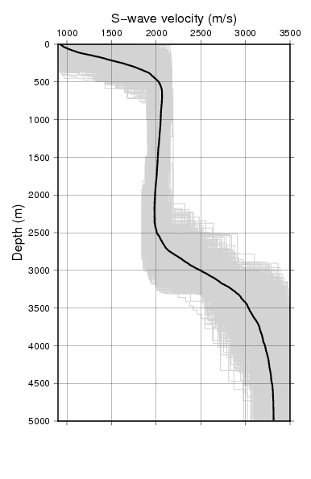
Invert for S-wave velocity vs depth with a neighbourhood algorithm
Start with randomly generated models (S-wave velocity and layer thickness), with some constraints.
Randomly perturb model parameters of the best-fitting models.
Accept new models if data misfit is lower.
Wathelet, 2008.
Sambridge, 1999.
Generate 5000 possible models.
Accept all models with dispersion curves with misfit lower than 25% (for Rayleigh) or 35% (for Love) to the group velocity tomography.

