Slide 1
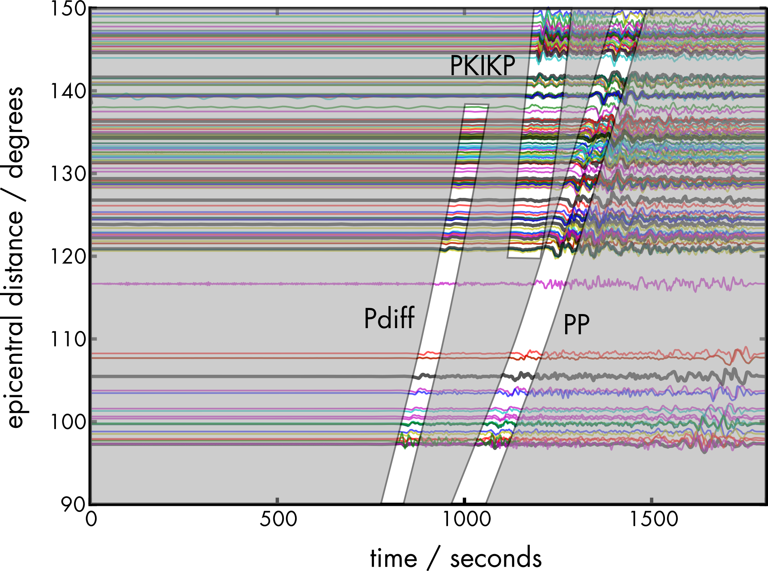
Fully probabilistic source inversion
Karin Sigloch & Simon Stähler
U. Oxford ETH Zurich
Stähler, S. C., & Sigloch, K. (2014). Fully probabilistic seismic source inversion-Part 1: Efficient parameterisation. Solid Earth, 5(2), 1055.
Stähler, S. C., & Sigloch, K. (2016). Fully probabilistic seismic source inversion-Part 2: Modelling errors and station covariances. Solid Earth, 7(6), 1521.

Slide 2
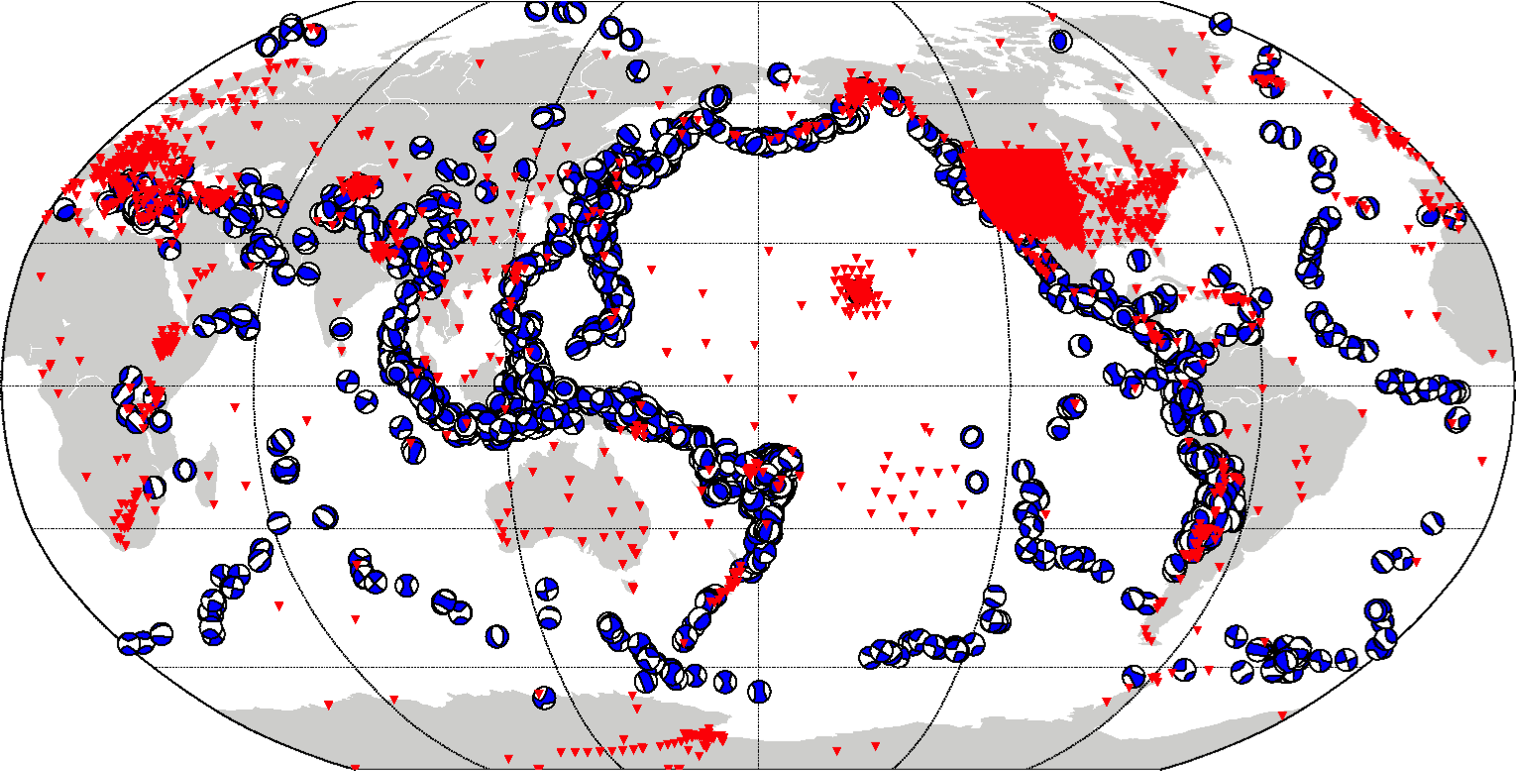
Blue: moderate to large earthquakes from 1999-2010, used for waveform tomography. Red: Recording broadband stations.
For global-scale waveform tomography,
we require earthquake source parameters for waveform modelling.

Slide 3
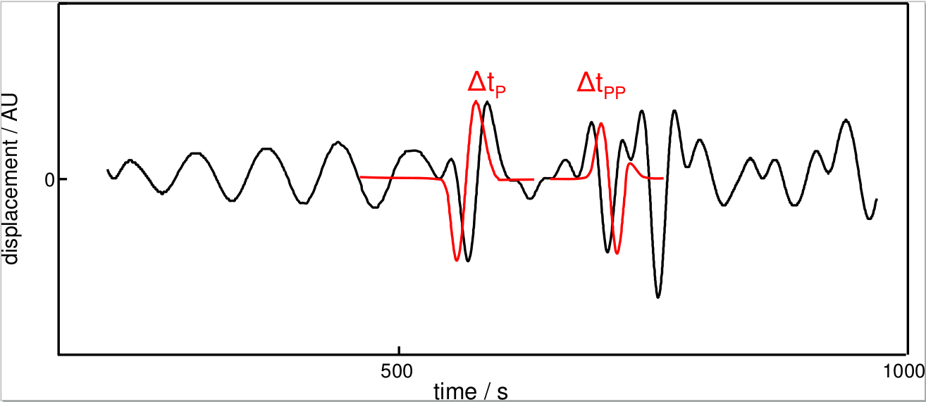
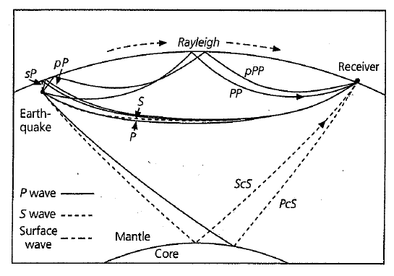
Why not use existing source catalogues?
Input for finite-frequency waveform tomography are traveltime delays dT (or amplitude anomalies dA/A) measured by cross-correlation misfit.
Estimating measurement variances σ²(dT) is challenging. And covariances are almost always neglected.
Main causes of msmt errors are misestimates of earthquake source properties → motivation to estimate sources.

Slide 4
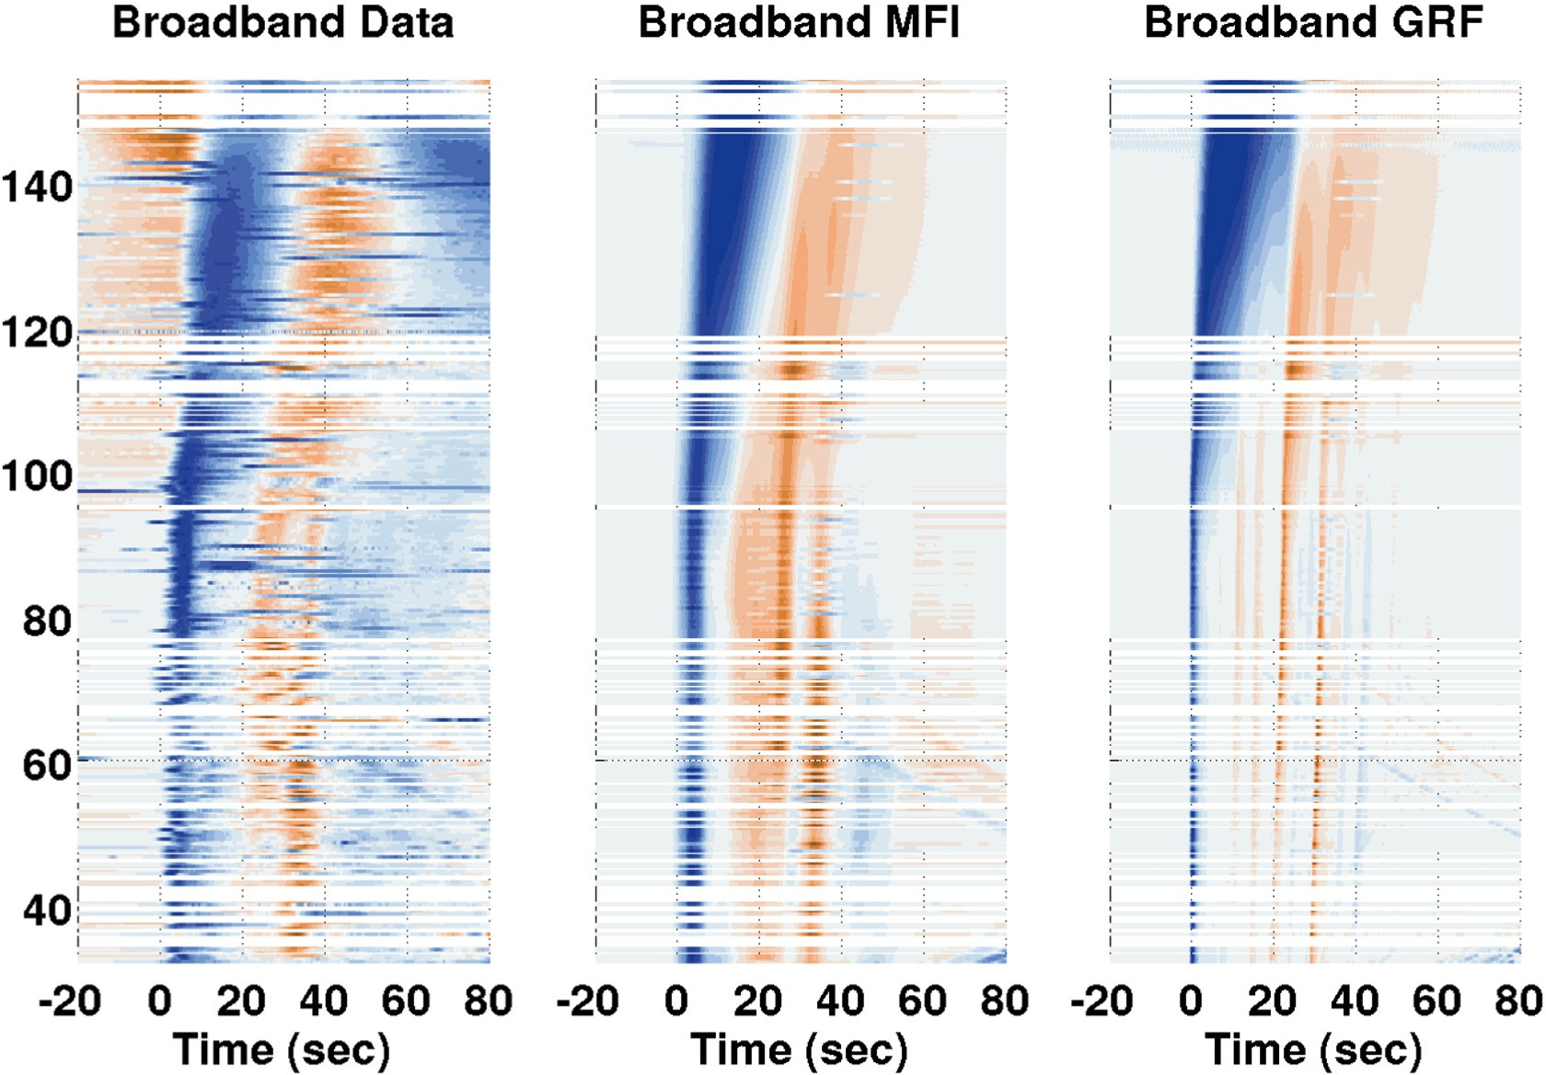
Harnessing core-diffracted waves
Broadband waveform example, P+Pdiff recorded on USArray
observed
Green’s fctns
m_{b} 7.5 event in Sumatra, depth 82 km, 2009/09/30
= *
epicentral distance
Modeling: AxiSEM, YSpec

Slide 5
Harnessing core-diffracted waves
Broadband waveform example, P+Pdiff recorded on USArray
observed
predicted: GRF * STF
Green’s fctns
epicentral distance
Modeling: AxiSEM, YSpec

Slide 6
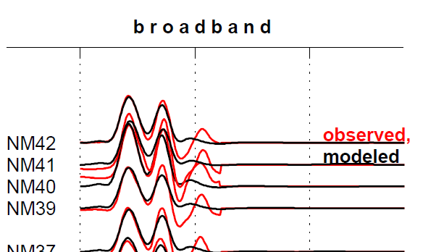
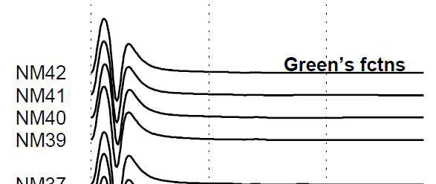
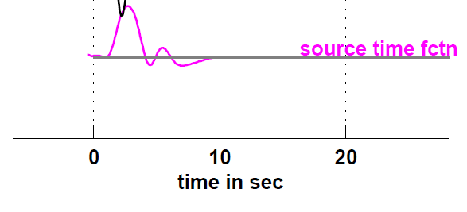
Most needed: correct source depths and source time functions.
Bb Green’s functions often differ dramatically from observed bb seismograms.
Wrong depth estimate causes wrong spacing of depth phases pP, sP.
Source time function convolves Green’s function, it reflects earthquake rupture process. Not estimated by any earthquake service.
P, pP, sP phases

Slide 7
We have been deconvolving source time functions from teleseismic broadband seismograms since 2005.
Deterministic approach, user interaction time is non-negligible.
Problem is non-linear in depth.
Showing source-time function solutions for different trial depths, for a m_{b} = 6.0 Aleutians earthquake.

Slide 8
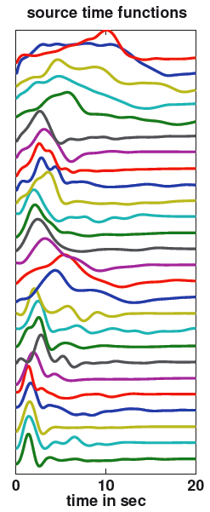
Fully probabilistic source inversion
Deconvolved ~4000 source time functions deterministically & semi-automated. Want to automate, using experience as prior knowledge.
Why Bayesian? Ensemble of stfs propagates source uncertainties into waveform uncertainties and thus dT uncertainties.
Nonlinear problem (in depth). Limited number of unknowns (1 for depth, 6 for moment tensor, 4-12 for stf).

Slide 9
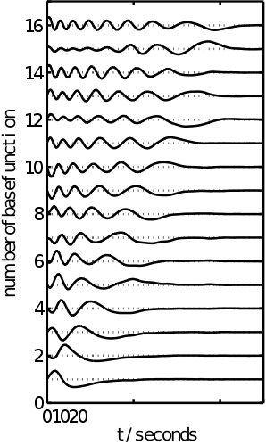
Bayesian source inversion: empirical basis functions
Nonlinear problem → need to parameterize the unknown STF by only a few basis functions.
Solution: we decomposed our 900 most robust, manually deconvolved STFs into empirical orthogonal functions (EOFs).
Monte Carlo scheme (Neighbourhood algorithm) draws the weights of the first 4-8 first EOFs, to synthesize/approximate the posterior distribution of the STF.

Slide 10
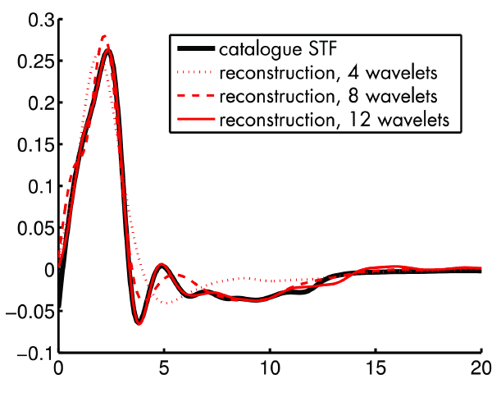
Bayesian source inversion: empirical basis functions
A source time function approximated by 4, 8, or 12 EOFs. For Monte Carlo sampling, the number should and can be small.

Slide 11
Harnessing core-diffracted waves
Bayesian source parameters, estimates for one event.
Yields an ensemble of solutions that fit the observed waveforms well. What do they agree upon?
Example: Here we learn about an m_{b} 5.9 event in Virginia, U.S.A. that…
Waveform fits for one STF solution
…depth was between 0 km and 10 km…
time
…STF was ~5 s long, single-peaked…
depth
…and clearly
a thrust mechanism.

Slide 12
Bayesian source parameters, estimates for one event
In the end, no need to decide on one solution. Rather, we propagate STF uncertainties into uncertainties of traveltime delay dT, and then use mean and variance of dT as input data for tomography.
σ(dT) in s
…depth was between 0 km and 10 km…
time
…STF was ~5 s long, single-peaked…
depth
…and clearly
a thrust mechanism.

Slide 13
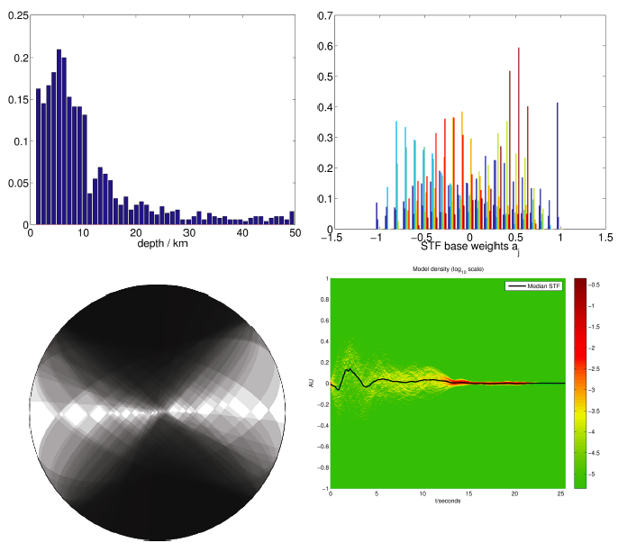
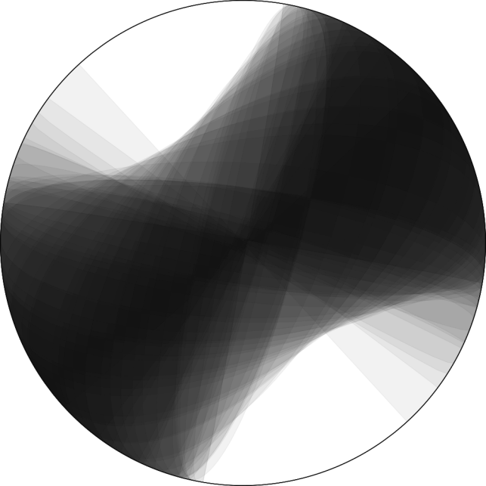
Probabilistic approach particularly powerful for “complicated” events.
Example of an ambiguous source mechanism: two plausible source depths (the posterior pdf has modes around ~5 km and 13 km).
Strike slip or thrust mechanism?
Long term goal: routine estimation, complete catalogue. (Like SCARDEC at IPG Paris, but with full uncertainty appraisal.)
posterior pdf of source depth, has two modes

Slide 14
Part 2: Given a candidate source solution, how to quantify its Likelihood given the observed data misfit?
Candidate source solutions m_{A} and m_{B} each generate N waveform misfits D_{j} at N recording stations. Which solution is “better”, i.e., more likely? How likely compared to all others?
→ Need to discover Likelihood function L_{D}(D|m).

Slide 15
Part 2: Given a candidate solution, how to quantify its Likelihood given the observed data misfit?
A good set of earthquake source parameters fits the observations but not the noise. → A proper noise model is required for any Bayesian sampling scheme. Its distribution will be N-variate, where N is the number of measurements.
We have been making cross-correlation measurements, i.e., using as a measure of fit the Pearson x-correlation coefficient CC_{j} between an observed and a predicted waveform.
Decorrelation D_{j} = 1-CC_{j} is an associated measure of misfit.
We investigated the properties of noise on D_{j}, with the goal of deriving the noise model for our Likelihood function L_{D}(D|m).

Slide 16
Investigated decorrelation D=1-CC on the reference set of 900 deterministic source estimates (which was based on 200,000 cross-correlation measurements).
Main factor determining D turns out to be Signal-to-Noise ratio of the observed seismogram.

Slide 17
Empirical findings about Likelihood function L_{D}
For any fixed SNR, decorrelation D_{j} turns out to be almost log-normally distributed.
D_{j} is correlated between neighbouring stations. (But not between time samples, since x-corr eliminates time by integration over seismogram.)

Slide 18
Empirical finding is that Likelihood function L_{D}(D|m) is closely approximated by a log-normal distribution.
An analytical, multivariate distribution! Depends only on means and co-variances, like an n-variate normal distribution.

Slide 19
Conclusions
Waveform-based estimation of earthquake source parameters:
Sits at the interface between source and structural studies.
Delivers better constraints on: depth;
source time function; moment tensor.
Fully probabilistic approach:
Delivers FULL insight into uncertainties
and co-variances.
Computationally feasible with our low-dimensional
parameterisation (<20 unknowns).
Incorporates extensive experience with deterministic
source inversion as prior knowledge.
Stähler, S. C., & Sigloch, K. (2014). Fully probabilistic seismic source inversion-Part 1: Efficient parameterisation. Solid Earth, 5(2), 1055.
Stähler, S. C., & Sigloch, K. (2016). Fully probabilistic seismic source inversion-Part 2: Modelling errors and station covariances. Solid Earth, 7(6), 1521.

Slide 20
EXTRA SLIDES

Slide 21
In the presence of real-world noise (convolved and additive), cross-correlation is a robust measure of waveform misfit.
More robust than l₁ or l₂ norms!

Slide 22
Bayesian source inversion
posterior pdf’s of the 6 basis function weights
Fitting broadband teleseismic P- and S-seismograms from GSN stations to WKBJ synthetics.
Neighborhood Algorithm draws 50,000+250,000 samples per event. Takes ~25 CPU hours.
Example: Moderately complicated event (Virginia, USA 2011, mb 5.9).
posterior pdf of the source time function
displacement
black line = median
time (0-25 sec)

